Slide 1
Airbnb(New York) Data Analysis
Soma Sai Teja
12017678
RK20CHA33

Slide 2
Agenda
Introduction
Data Cleaning
Univariate Analysis
Bivariate Analysis
Conclusion

Slide 3


Introduction
It is an American company that operates an online marketplace for lodging, primarily homestays for vacation rentals, and tourism activities.
Since 2008 a lot of hosts and guests have used Airbnb for stay purpose to travel conveniently and lead a professional view of life, now it became one of the world’s largest services that is recognized by everyone.
I chose this dataset because, since Airbnb has become large and it needs some changes based on the customers reviews, by analysing the data Airbnb can take business decisions, guiding marketing initiatives, implementation of additional services and much more.

Slide 4
Topic one
Data Cleaning

Slide 5
Data Cleaning
Data scientists spend a large amount of their time cleaning datasets and getting them down to a form with which they can work.
Therefore, it is important to be able to deal with messy data, whether that means missing values, inconsistent formatting, malformed records, or nonsensical outliers.
Most used traditions while cleaning the data in the project:
Dropping unnecessary columns in a data frame.
Changing the index of a data frame.
Using .str() methods to clean columns.
Using the dataframe.applymap() function to clean the entire dataset, elementwise.
Renaming columns to a more recognizable set of labels.
Skipping unnecessary rows in a csv file.

Slide 6
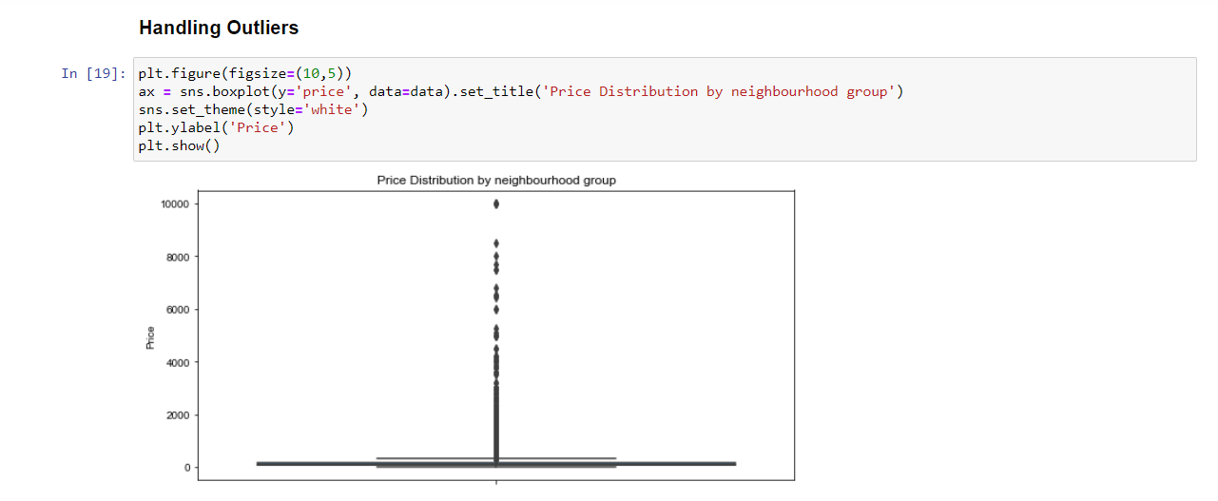
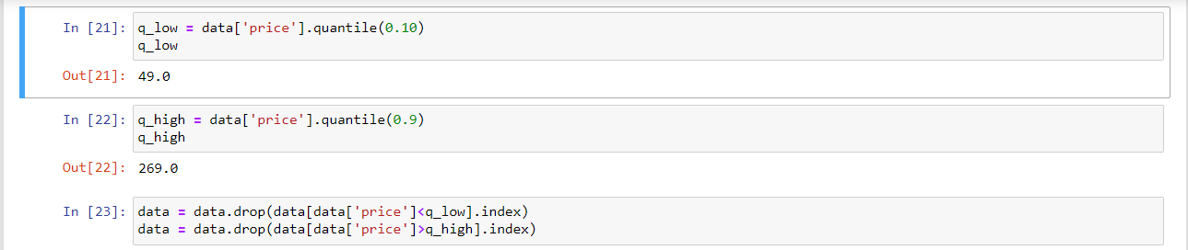
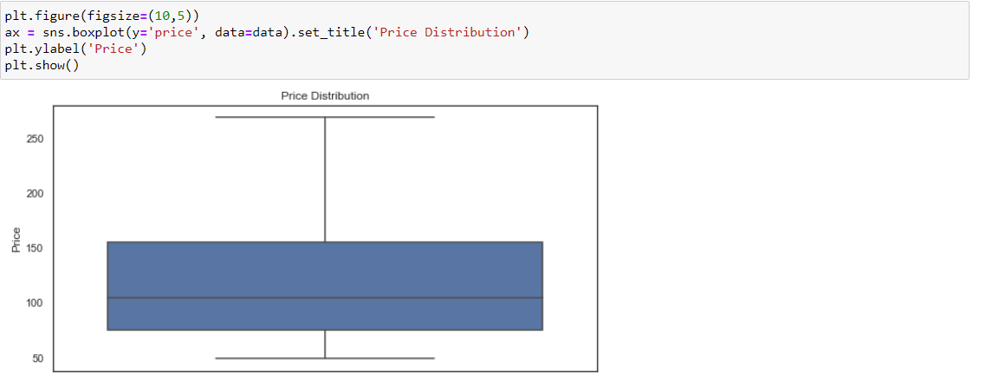

Slide 7
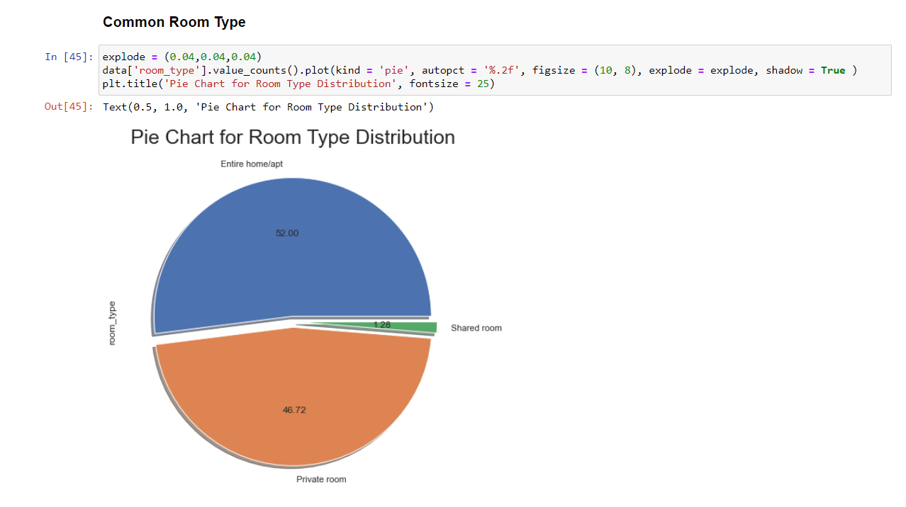
Univariate Analysis
Univariate Analysis is the simplest form of analyzing data. ‘Uni’ means ‘one’, so in other words your data has only one variable. It doesn’t deal with causes or relationships and its major purpose is to describe. It takes data, summarizes that data and finds patterns in data.
Here I performed a pie chart to see the percentage on which room is preferred most.

Slide 8
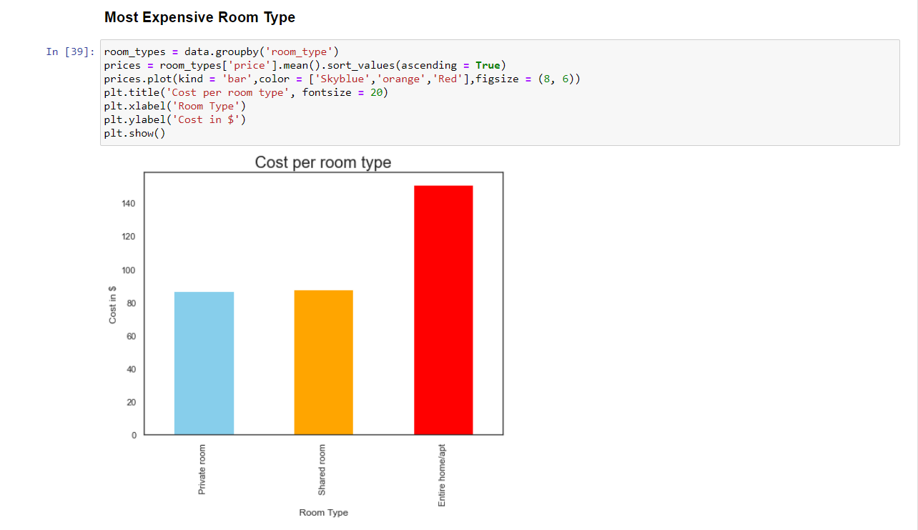
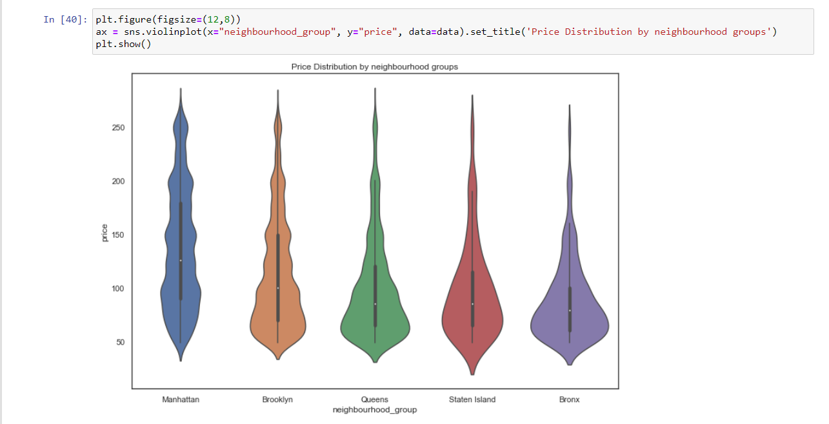
Bivariate Analysis
Bivariate Analysis lets us to know the relationship that exists between two variables. This has a lot of use in real life. It helps us to find out if there is an association between the variables and if yes then what is the strength of association.

Slide 9
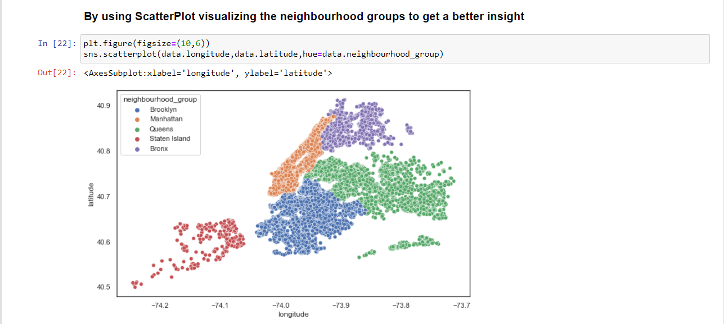
Bivariate

Slide 10
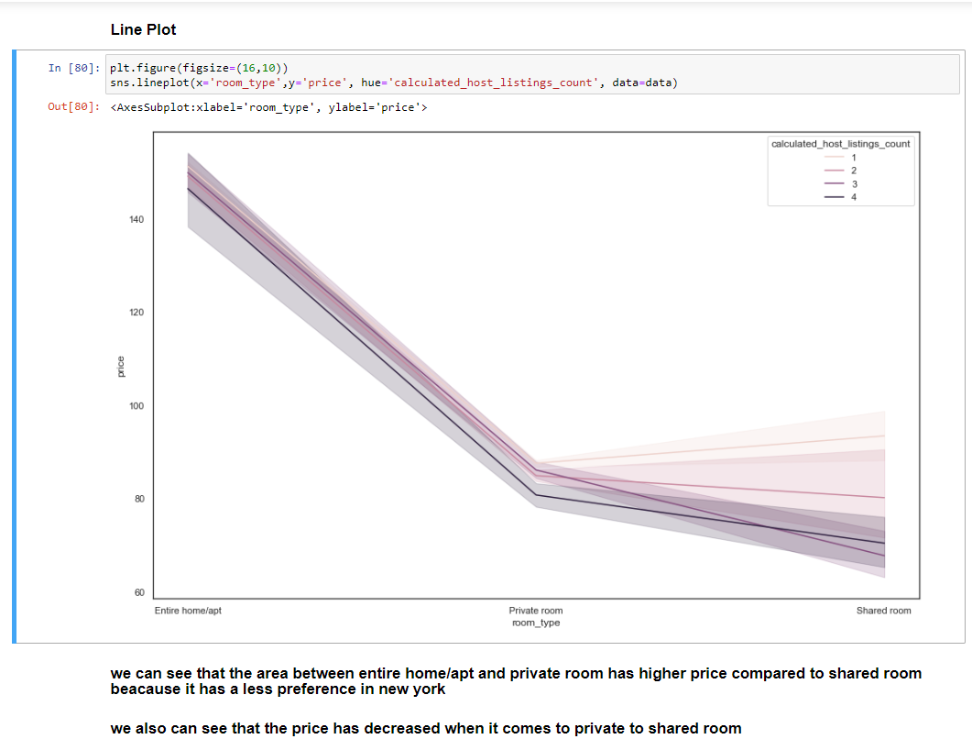
Multivariate Analysis
Multivariate Analysis is defined as a process of involving multiple dependent variables resulting in one outcome. This explains that the majority of the problems in the real world are Multivariate. For example, we cannot predict the weather of any year based on the season. There are multiple factors like pollution, humidity, precipitation, etc. Here, we will introduce you to multivariate analysis, its history, and its application in different fields.

Slide 11
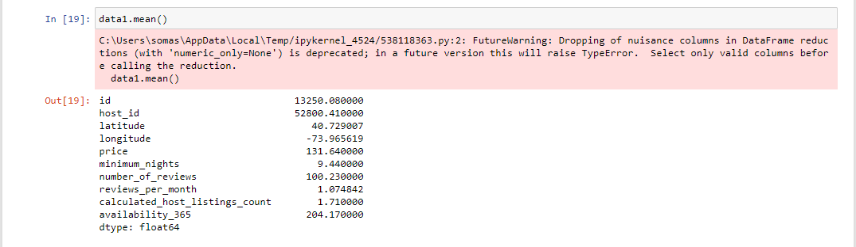
Statistical Analysis
It is the science of collecting, exploring and presenting large amounts of data to discover underlying patterns and trends. Statistics are applied every day in research, industry and government- to become more scientific about decisions that need to be made.

Slide 12
Conclusion
Walmart dataset. This dataset provides us with the data related to the factors that are affecting the sales of the Walmart Franchise in different locations..
From the above data analysis, we can say that the temperature, unemployment, fuel price, cpi are some of the factors that are affecting the sales of the Walmart Franchise..
Walmart uses many data analysts to know the best time to sell a commodity and when to keep up with stock of commodity..
Through the above data analysis, we got to know about the highest number of sales at a particular time in a year.
We also got to know about the factors that are affecting the sales of the Walmart Franchise.
It is the data of the years 2011,2012,2013,2014..

Slide 13
References
I have tried Kaggle problem as a part of my self-case study. The main description and data of the case study can be found in this link: https://www.kaggle.com/c/walmart-recruiting-store-sales-forecasting
The entire data is found in this link and is open source and downloadable.

Slide 14
Thank you
Soma Sai Teja .G
somasaiteja0@gmail.com@gmail.com
12017678
RK20CHA33

